Slide 1


SENGUNTHAR COLLEGE OF ENGINEERING COMPLAINT MANAGEMENT SYSTEM
PROJECT GUIDE:
Mr. M . KARTHIKEYAN M.E., ASSOCIATE PROFESSOR, INFORMATION TECHNOLOGY
PRESENTED BY
R.CHANDRU (612220205006)
J.S.KAVIN PRAKAASH (612220205015)
A.NAVIN (612220205018)
E.PRAVEENKUMAR (612220205020)

Slide 2
ABSTRACT
The aim of this project is to develop a software application that allows Government and city corporation to manage customer complaints efficiently.
It provides a structured approach to handling complaints, ensuring that they are addressed in a timely and effective manner.
The system can be used by customers, agents, and administrators to submit, assign, and resolve complaints.
The complaint management system includes features such as complaint submission forms, complaint tracking, complaint assignment, status updates, and reporting.

Slide 3
OBJECTIVE
The objective of a complaint management system is to provide a structured and efficient approach to handling customer complaints.
The system aims to improve customer satisfaction and loyalty by ensuring that complaints are addressed in a timely and effective manner.
The system also benefits agents and administrators by providing them with tools to track and manage complaints, and to generate reports that can be used to identify trends and make data-driven decisions.
The overall objective of a complaint management system is to enhance communication and collaboration among users, and to improve the overall complaint handling process.

Slide 4
INTRODUCTION
Complaints are a common occurrence in any business or organization, and if not handled properly, they can result in dissatisfied customers, negative reviews, and damage to the reputation of the business.
A complaint management system provides a centralized platform for managing complaints, allowing agents and administrators to track, assign, and resolve complaints in a transparent and efficient manner.
The system typically includes features such as complaint submission forms, complaint tracking, complaint assignment, status updates, and reporting.
It allows customers to submit complaints through a user-friendly web interface, and agents to manage complaints through a dashboard.
Administrators can monitor complaints, generate reports, and make changes to the system as needed.

Slide 5
EXISTING SYSTEM
Commercial software solutions can be expensive: Many of the popular complaint management systems available in the market are commercial software solutions, which can be expensive to purchase and maintain. This can be a barrier for small businesses or organizations with limited budgets.
Complexity: Some complaint management systems can be complex and difficult to use, requiring extensive training for agents and administrators. This can lead to frustration and errors if users are not properly trained
DISADVANTAGES:
Lack of flexibility
High cost
Reporting limitations
Inability to handle complex complaints
Inadequate customer feedback mechanisms

Slide 6
PROPOSED SOLUTION
A user-friendly cloud app that allows customers to submit complaints online. The cloud app should be easy to use and provide clear instructions for submitting a complaint.
A system for tracking complaints and assigning them to appropriate agents or teams based on the nature of the complaint. This should include automated notifications to agents when new complaints are submitted.
A system for agents to communicate with customers and resolve complaints in a timely and effective manner. This may include tools for tracking the status of complaints, updating customers on progress, and escalating complaints when necessary.
The system should be designed with security and privacy in mind, and should include measures to protect customer data and prevent unauthorized access.

Slide 7
ADVANTAGES
User-Friendly Interface
Cost-Effective Solution
Widely Accessible
High-Quality Output

Slide 8
SYSTEM REQUIREMENTS
HARDWARE REQUIREMENTS :
Processor : Intel Core i3 Processor
Hard Disk Capacity : 40 GB
RAM : 8 GB
SOFTWARE REQUIREMENTS :
Operating System : Windows 7/8/10/11
Front End : HTML
Frame work : Flask
Scripting Language: Python 3.10.4
Back End : SQlite3
Containerization : IBM kubernetes

Slide 9
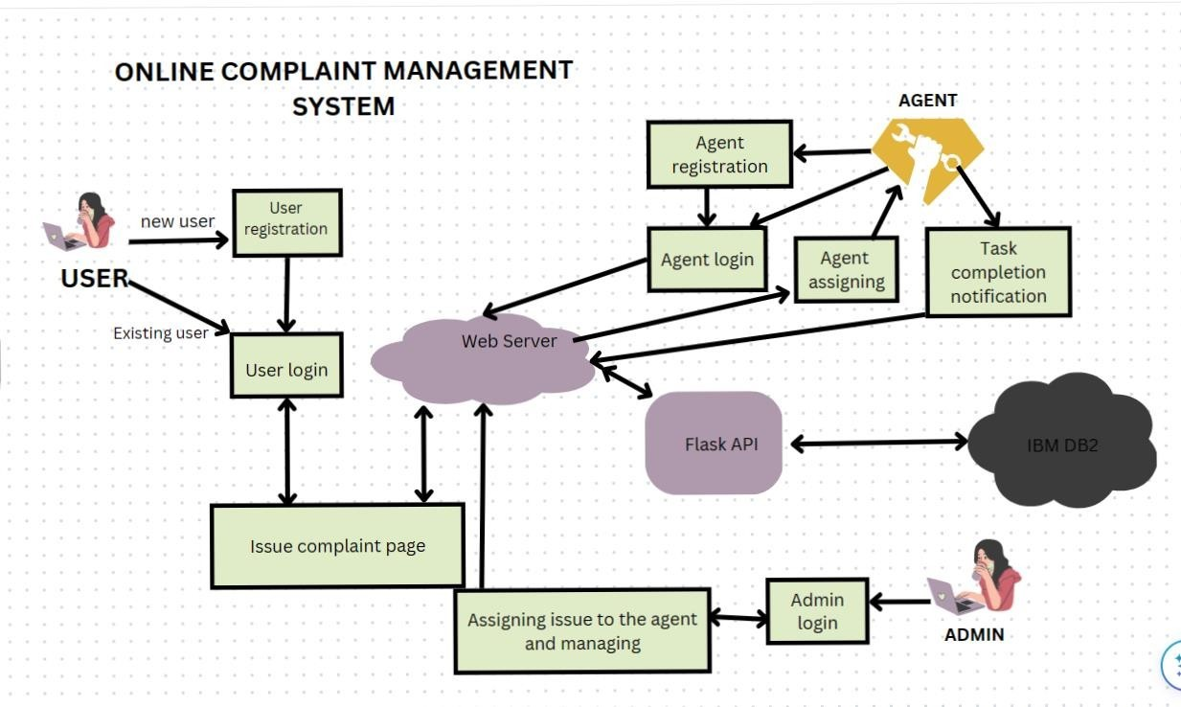
SOLUTION ARCHITECTURE

Slide 10
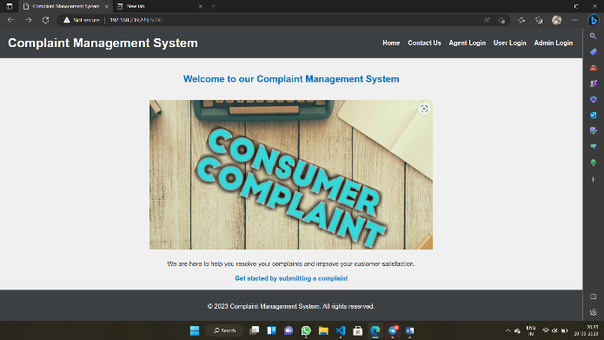
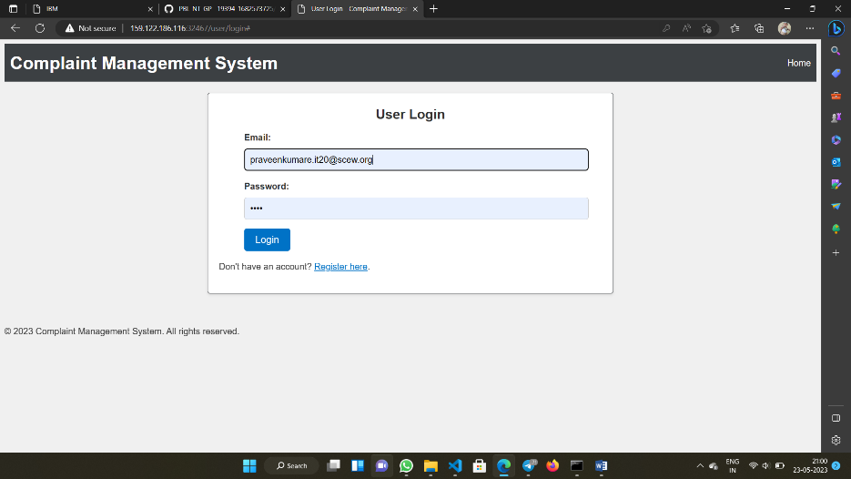
PROJECT FLOW IMPLEMENTATION
HOME PAGE USER LOGIN

Slide 11
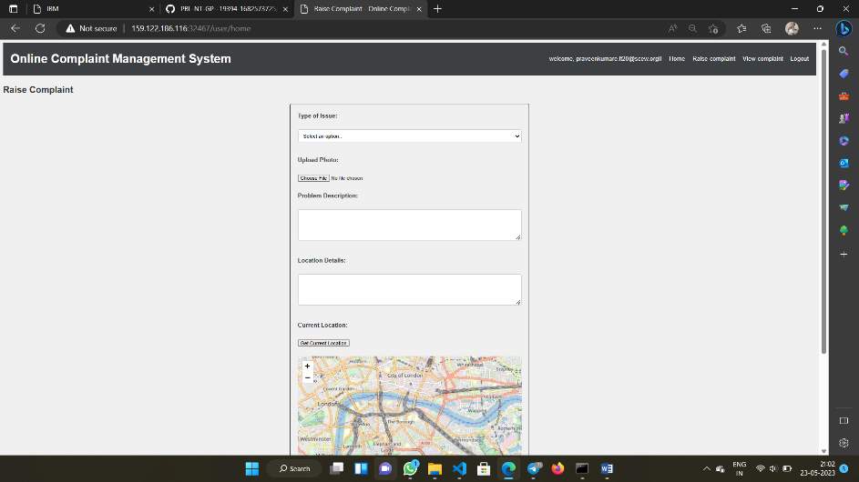
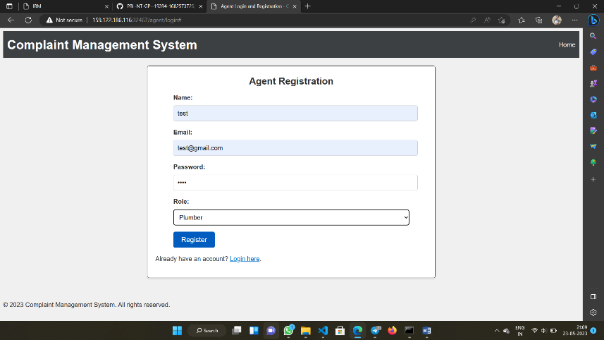
USER HOME PAGE AGENT LOGIN

Slide 12
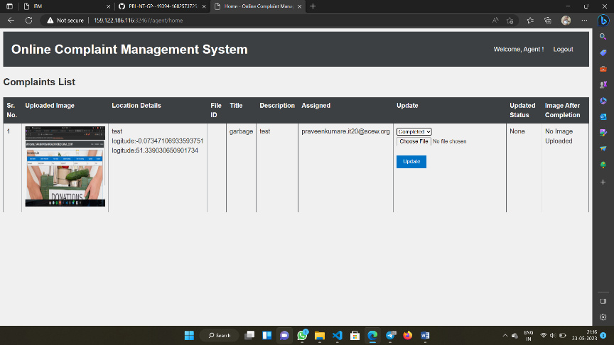
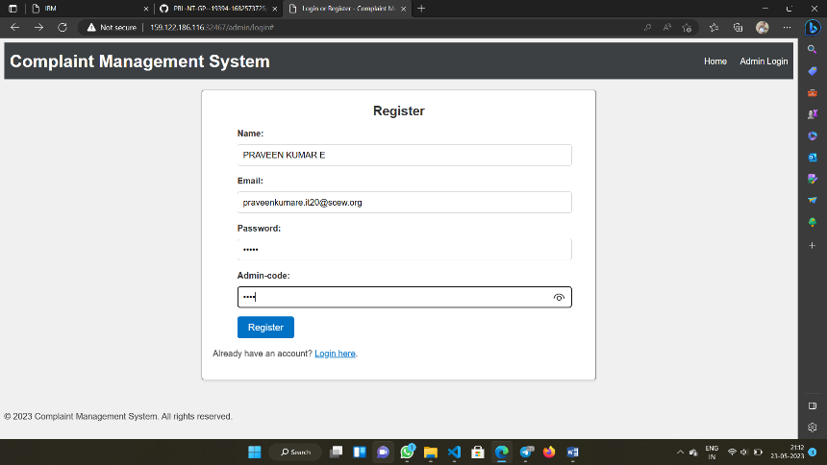
AGENT HOME PAGE ADMIN LOGIN

Slide 13
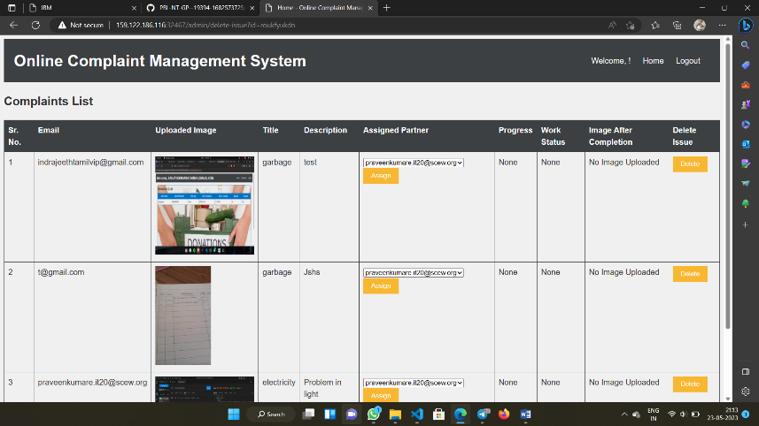
ADMIN HOME PAGE

Slide 14
FUTURE ENHANCEMENT
Artificial intelligence (AI) and machine learning (ML) will play an increasingly important role in customer complaint systems, as they can help businesses analyze large volumes of data and identify patterns and trends that can inform product or service improvements.
Social media platforms will continue to be an important channel for customer complaints, and businesses will need to develop strategies to effectively manage complaints on these platforms.
Mobile apps and chatbots will become more prevalent in customer complaint systems, allowing customers to quickly and easily report issues and receive prompt responses.

Slide 15
CONCLUSION
In conclusion, a complaint management system is a critical tool for organizations to manage customer complaints efficiently and effectively. By providing a structured approach to complaint handling, the system ensures that complaints are addressed in a timely and satisfactory manner, resulting in increased customer satisfaction and loyalty.
A complaint management system should include key features such as a complaint submission form, complaint tracking and assignment, complaint resolution, reporting and analytics, integration with other systems, customization options, security and privacy measures, multilingual capabilities, automation capabilities, effective feedback mechanisms, and scalability.

Slide 16
REFERENCES
Artificial intel"Complaint Management System" by Oracle: This system helps businesses manage customer complaints and feedback by centralizing all customer interactions and providing tools for tracking, analyzing, and resolving complaints. https://www.oracle.com/cx/service/complaints-management/
"Zendesk" by Zendesk Inc.: This cloud-based customer service software suite includes a complaint management system that allows businesses to receive, track, and manage customer complaints across various channels such as email, social media, and chat. https://www.zendesk.com/solutions/complaint-management/
"Freshdesk" by Freshworks Inc.: This customer service software includes a complaint management system that enables businesses to manage customer complaints and feedback across all communication channels, including email, phone, social media, and chat.https://freshdesk.com/customer-service/complaint-management/
"Salesforce Service Cloud" by Salesforce: This cloud-based customer service software suite includes a complaint management system that allows businesses to track and resolve customer complaints across multiple channels, including email, phone, social media, and chat.https://www.salesforce.com/products/service-cloud/features/complaint-management/

Slide 17
THANK YOU !!

